Slide 1
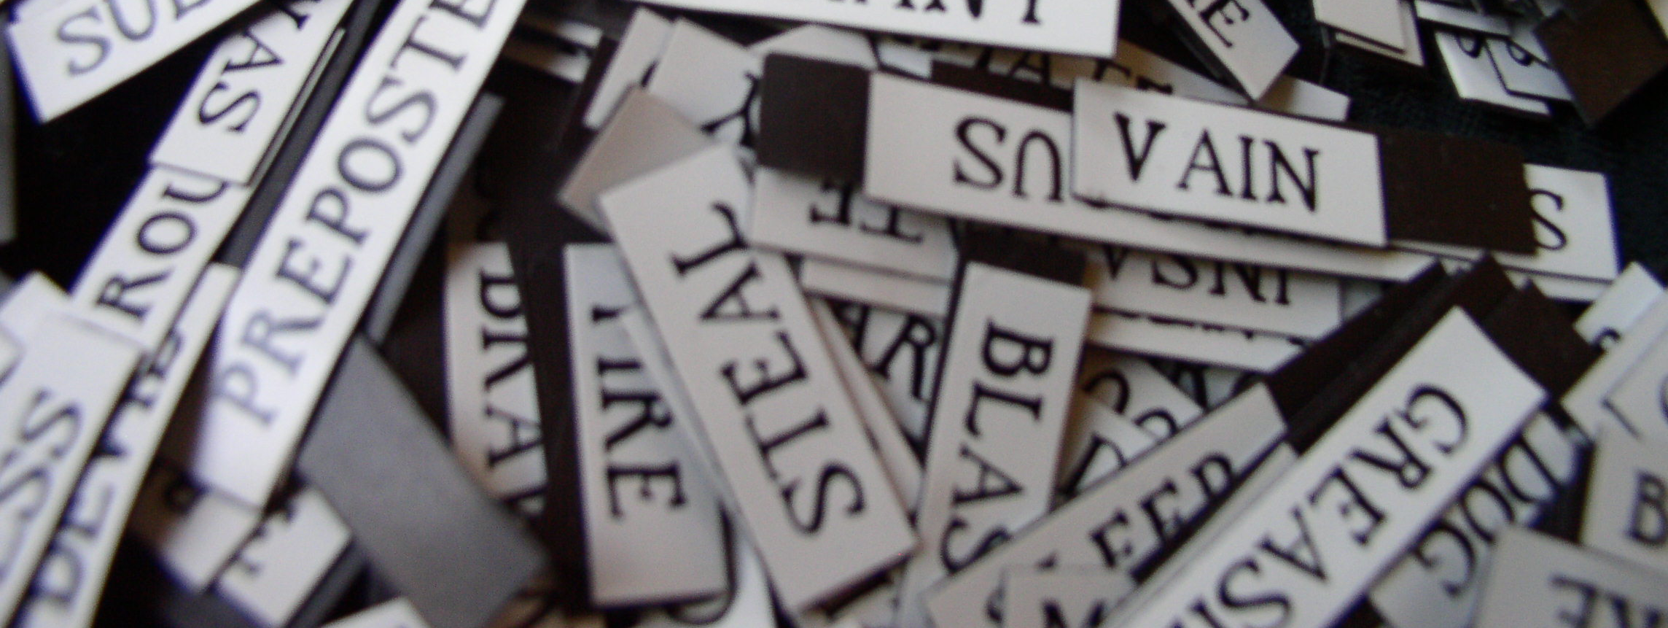
Is my model on topic?
Bob van de Velde
VU University Amsterdam

Slide 2

Looking for broad-stroke topic validation

Slide 3
The prompt
Topic models are ideal when comparing unstructured texts of many sources
There are multiple choices to pre-process data, with different results
It’s hard to know how these choices compare in terms of topic model fit with reality.

Slide 4
The goal
Make a workflow which provides some insight into the fit between topic models and reality through external ‘labels’
  Labels denote documents which should share a focus on specific topics, e.g. :
    newspaper sections
    Fields in which organizations are active
    Divisions at ICA
  A good topic model should
    Have topics specific to these labels(discriminant validity)
    Tell us how likely a label is (predictive validity)

Slide 5
The approach
Using ICA 2015 papers
Three alpha (topic-distribution levels)
  0.5 ( loglikelihood – 219337.4)
  1.0 ( loglikelihood – 210602.8)
  1.5 ( loglikelihood – 208835.3)
Test by
  Running individual negative binomial models for each division
  Keep only significant predictors
  Compare results between models

Slide 6
Picking models
Discriminant validity:
  Can topics distinguish divisions?
  Low overlap in between divisions’ predicting topics
Predictive validity:
  Together, can topics predict divisions?
  Low BIC scores for models

Slide 7
The results based on ICA 2015 abstracts

Slide 8
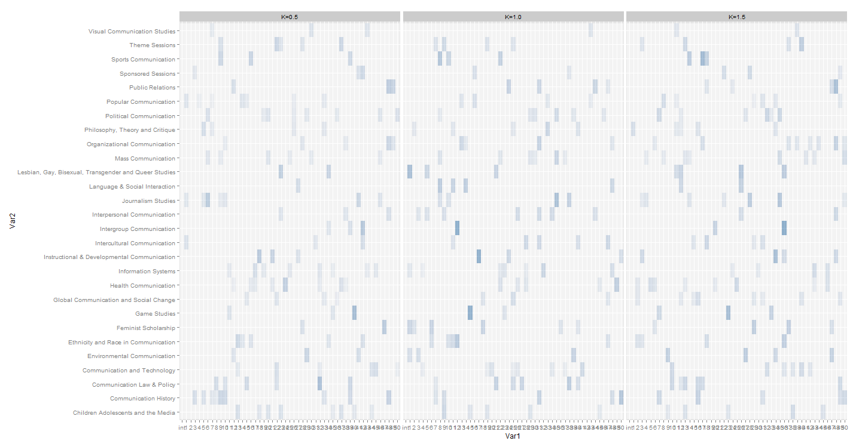
An overwhelming overview

Slide 9
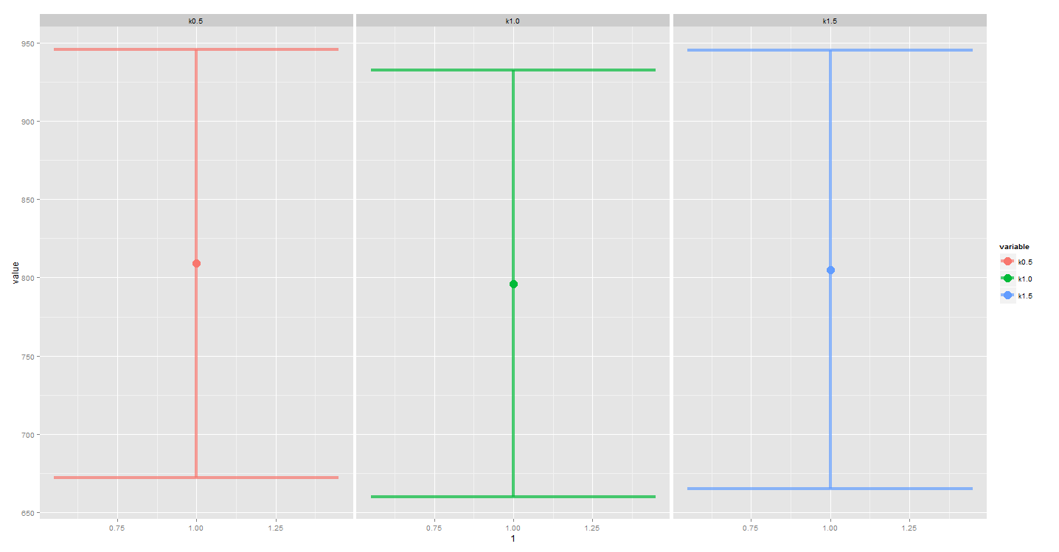
Comparing models: predictive validity

Slide 10
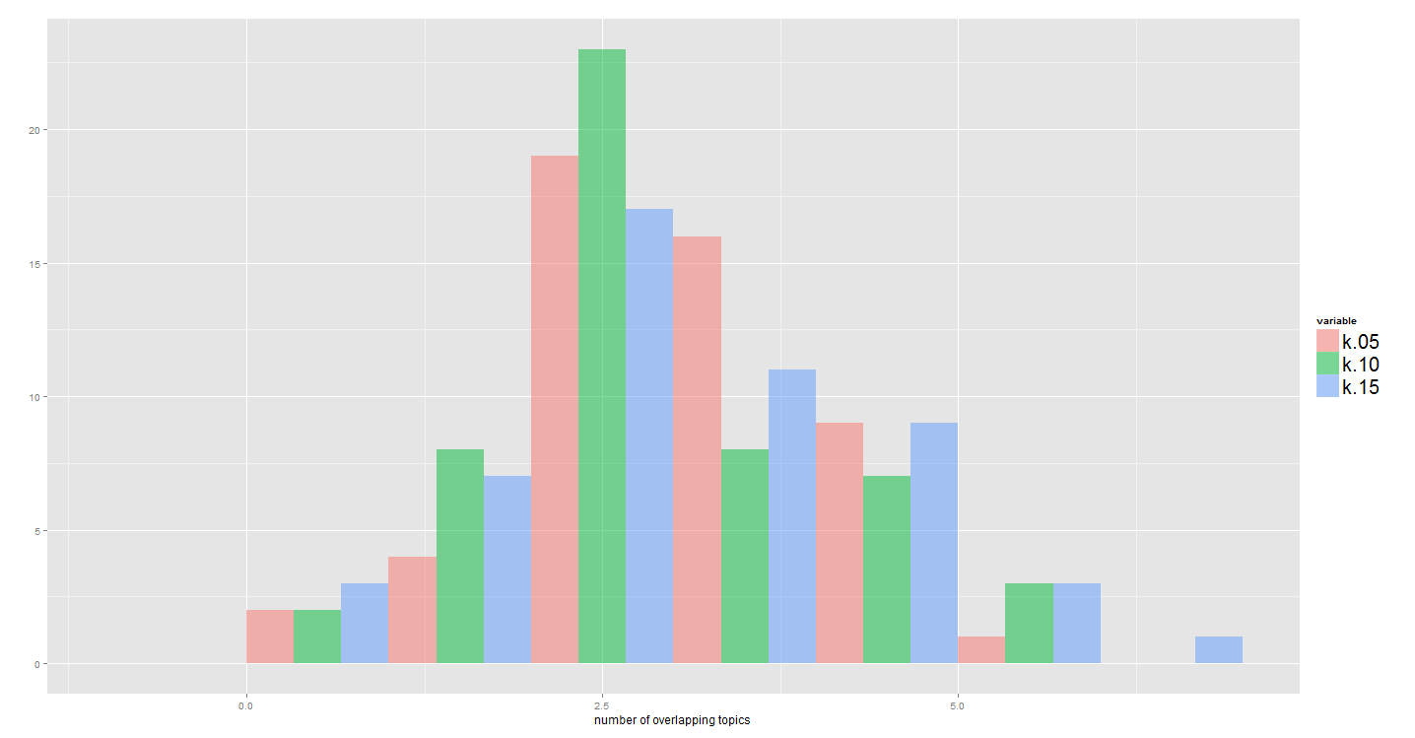
Comparing models: discriminant validity

Slide 11
Elaborating on insights

Slide 12
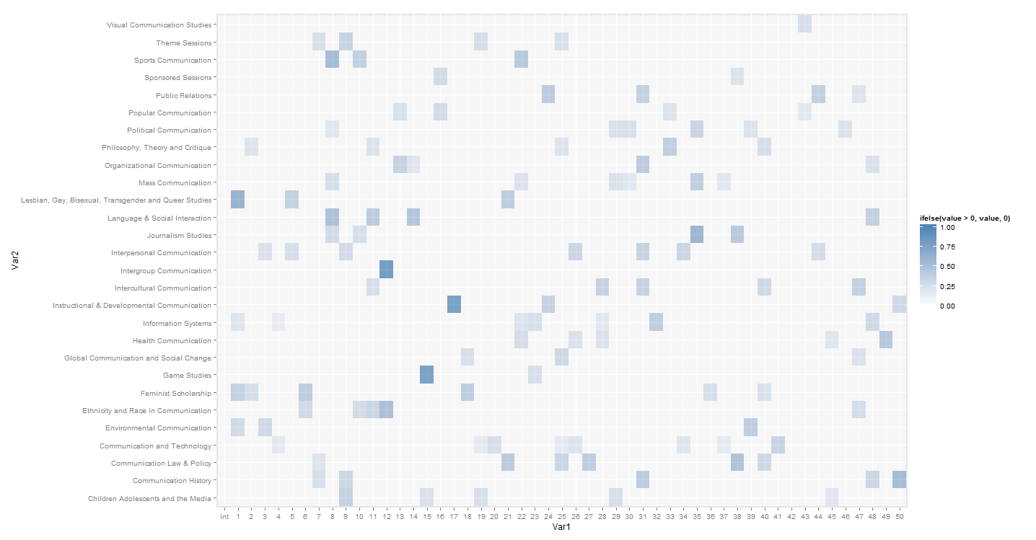
Digging deeper

Slide 13
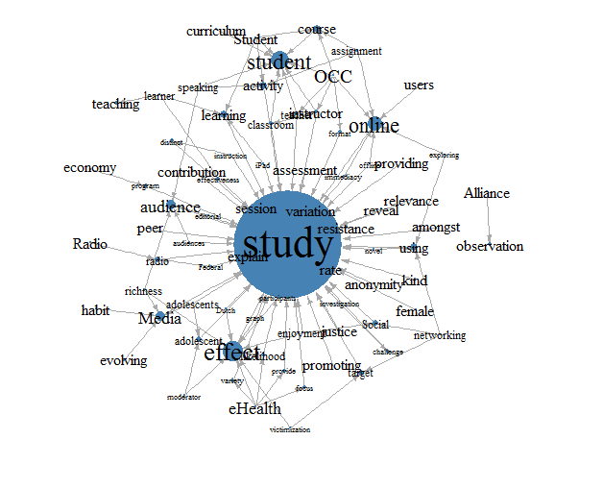
Specific Topic
Topic 17
Unique to instructional & developmental communication

Slide 14
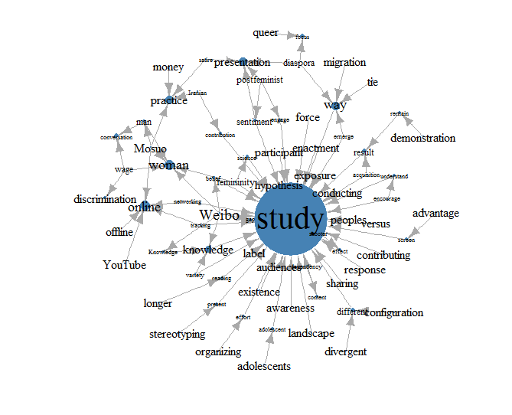
Shared topics
Topic 2, shared by
  LGBTQ studies
  Informal systems
  Feminist scholarship
  Environmental communication

Slide 15
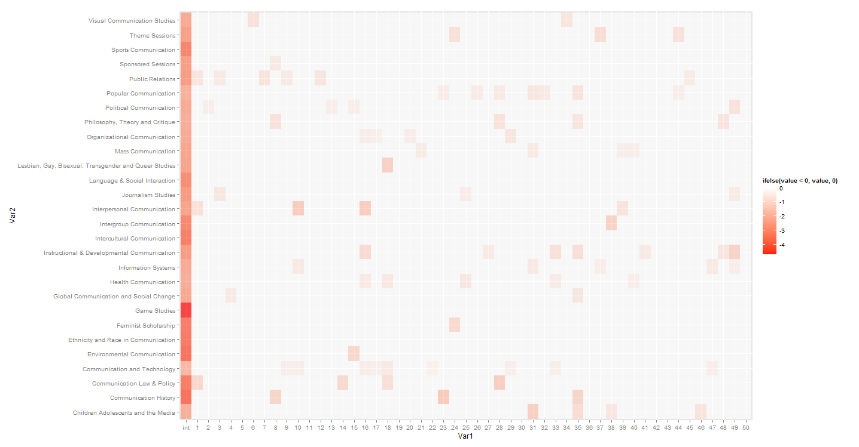
Defining absent topics

Slide 16
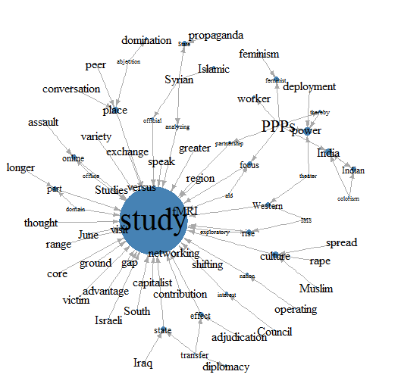
Absent topic
Topic 18
negatively predicts LGBTQ studies
Focusses on political aspects

Slide 17
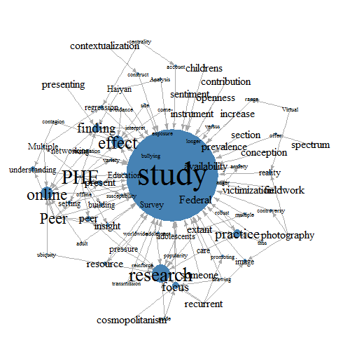
“junk” topics
Topic 42, no predictive value

Slide 18
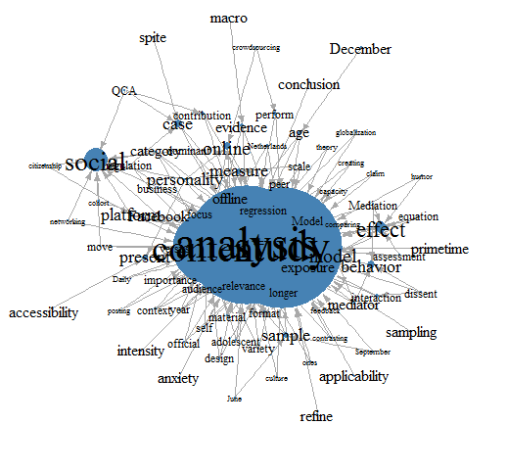
“junk” topics II
Topic 8 is shared by 5 divisions:
  Sports communication
  Mass communication
  Political communication
  Language and social interaction
  Journalism studies
  Contents seem mostly methodological

Slide 19
Some reflection
Applicability of this approach depends on research question
Generates a basic insight into model appropriateness
Lacking predictive and discriminant validity may result from either model or label problems

